Slide 1
(1) Calculate Replen. Item Quantity
(2) Calculate Redist. Preview
(3) Calculate Trips & Journal Lines
(4) Calculate Thresholds
(5) Create Transfer Orders
(6) Execute Transfer Orders

Slide 2
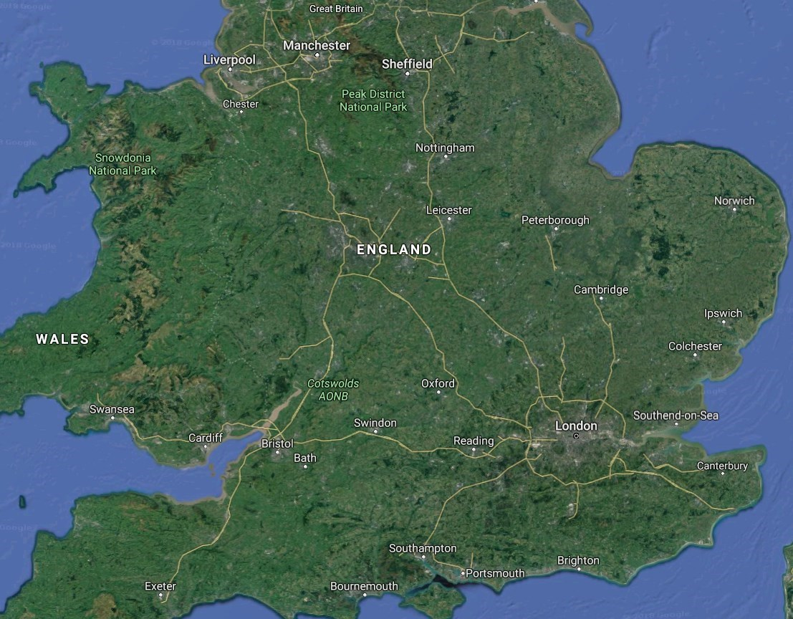
WHSE
Store5
Store2
Store4
Store3
Store1

